Slide 1
GLOBAL CIVIL SOCIETY REPORT
for the 2024 mid-term review of the Commission on Narcotic Drugs
Nazlee Maghsoudi, Chair, New York NGO Committee on Drugs Ganna Dovbakh, Deputy Chairperson, Vienna NGO Committee on Drugs
March 2024
Notes:
NM

Slide 2
Methodology
Global online survey between October & December 2023
available in five languages
focusing on the challenges identified in the 2019 Ministerial Declaration
173 responses from 69 countries & territories
4 regional consultations
hybrid consultations in Africa & Europe
online consultations in Asia-Pacific and the Americas
in close collaboration with regional fora, networks and working groups
focusing on pre-identified challenges from the 2019 Ministerial Declaration
Notes:
NM - Last year, we entered a joint agreement between the Vienna and the New York NGO Committee on Drugs to work together as equal partners to ensure the broadest and most inclusive civil society engagement in the 2024 mid-term review building upon the success of the Civil Society Task Force and other cross-committee collaborations. Since the announcement, we held extensive consultations to gather input from civil society organizations on progress and challenges in implementing international drug policy commitments. We held a global online consultation that resulted in inputs from civil society organizations around the world. We also hosted four regional consultations, namely for the Africa, Asia-Pacific, Europe, and Americas regions. All of these inputs, as well as civil society statements made at thematic discussions from 2019-2023, have been summarized in a Global Civil Society Report published by the NYNGOC and VNGOC as a written contribution to the midterm review, which we are pleased to present today as an important input from civil society for mid-term review discussions and beyond. QR code to download report.

Slide 3
Respondents Characteristics
Small organizations operating on a national level
Most respondent NGOs were relatively small, with 10 or fewer employees., operating at the national or local level in their respective countries.
The online survey was completed by 173 organizations, almost half of which were from Africa (47%). In total, responses were collected from 69 countries and territories around the world. Approximately 170 people participated in the four regional consultations, sharing their views and inputs on selected challenges identified in the 2019 Ministerial Declaration.
Organizations providing direct services and advocacy
The majority of the respondents who contributed identified as directly involved in service provision to people who use drugs and other community members or as advocacy organizations .
Prevention, Harm Reduction & Human Rights focus
Respondents indicated that their work focuses predominantly on the fields of health, education, and human rights-based approaches to address drug related issues with Prevention, Harm Reduction and Human Rights being the most mentioned.
Notes:
GB

Slide 4
Challenges | Progress | Neutral | Regression | NGOs working on the issue
Challenge 1: Expanding & diversifying range of drugs & drug markets | 48% | 16% | 31% | 61%
Challenge 2: Record levels of drug abuse & illicit cultivation, production & trafficking | 40% | 23% | 33% | 55%
Challenge 3: Health & regulatory challenges posed by synthetic opioids & non-medical use of prescription drugs | 42% | 23% | 32% | 58%
Challenge 4: Increase in drug-related deaths - unmet need for drug treatment and health services | 36% | 21% | 41% | 66%
Challenge 5: High transmission of HIV, HCV & other blood-borne diseases associated with drug use | 47% | 23% | 25% | 65%
Challenge 6: Adverse health consequences associated with new psychoactive substances | 37% | 25% | 31% | 61%
Challenge 7: Low availability of internationally controlled substances for medical & scientific purposes | 31% | 32% | 23% | 34%
Challenge 8: Increasing links between drug trafficking, corruption & other forms of organized crime | 37% | 18% | 35% | 43%
Challenge 9: Low value of confiscated proceeds of crime related to money laundering arising from drug trafficking | 19% | 16% | 49% | 18%
Challenge 10: Criminal misuse of information & communications technologies for drug trafficking | 35% | 24% | 24% | 27%
Challenge 11: Non-compliance of responses with international drug control conventions & human rights obligations | 26% | 36% | 24% | 39%
Progress made
Survey respondents were asked a series of questions for each of the challenges identified in the 2019 Ministerial Declaration, including whether efforts toward addressing the specific challenge were progressing, neutral, or regressing.
Notes:
GB

Slide 5
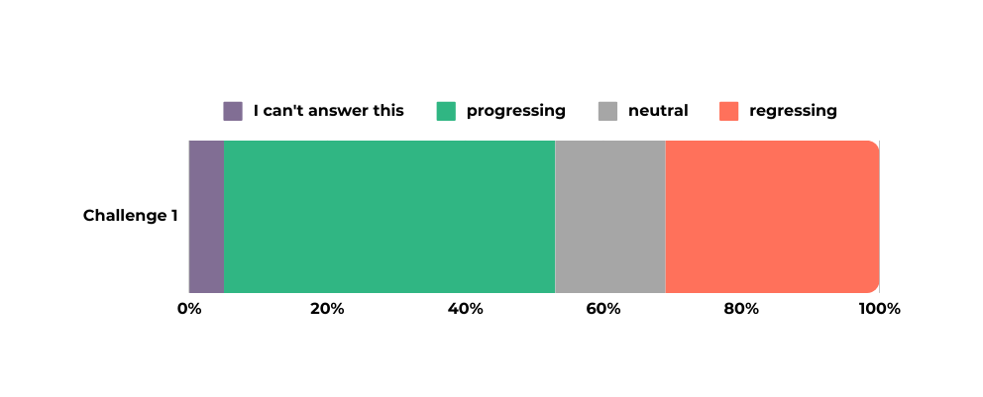
Progress made:
expansion of drug checking services
expansion of early warning systems
expansion of drug monitoring services
increased cohesion and alliances
Challenge 1
Expanding & diversifying range of drugs & drug markets
Challenges encountered:
North American drug toxicity and overdose crises
increase in contaminated substances
severe impacts on Indigenous populations, LGBTIQA+ communities, and those facing socioeconomic inequalities
lack of holistic approaches addressing both demand and supply reduction
concern that supply reduction interventions lead drug markets to shift towards more highly potent substances
some raised safe supply initiatives and legal regulation based on the outcome report of the OHCHR as more appropriate responses
NGO responses:
harm reduction, treatment, recovery, counseling, outreach, and rehabilitation
producing harm reduction materials for new substances and expanding the implementation of harm reduction programs
prevention programs for young people, as well as efforts in organizing awareness campaigns
Notes:
NM - Civil society input on this issue was widespread across all regions, with many highlighting the positive responses arising from the implementation and expansion of early warning systems, drug checking services, drug monitoring observatories, and alliances formed between these initiatives.
Respondents highlighted the global impact of synthetic drugs, particularly citing the North American drug toxicity and overdose crises. Responses noted the increased harm individuals experience when consuming unidentified and unknowingly contaminated substances, as well as the challenges faced by communities responding to overdoses affected by contaminated markets. Explicitly acknowledged severe impacts on Indigenous populations, LGBTIQA+ communities, and those facing socioeconomic inequalities, among others.
NGOs highlighted the lack of holistic approaches addressing both demand and supply reduction, the lack of political will for meaningful changes, and the limitations and challenges they experience in addressing social determinants under current drug policies.
Expressed concerns over a recurring phenomenon where scheduling and law enforcement activities lead drug markets to shift towards more highly potent - and thus more easily trafficable – comparable substances. In light of such a phenomenon, some participants argued that supply reduction interventions are ill-equipped to address the harms caused by diversifying drug markets, advocating instead for public health and human rights-based initiatives that can better address this challenge and the devastating loss of life caused by overdoses from consuming toxic unregulated substances.
While there was no consensus, some participants supported safe supply initiatives (i.e., provide pharmaceutical grade alternatives to contaminated drug supply to people who are at high risk of overdose), and legal regulation based on the outcome report of the Office of the High Commissioner for Human Rights titled "Human rights challenges in addressing and countering all aspects of the world drug problem."
Implementing a range of services, including harm reduction, treatment, recovery, counseling, outreach, and rehabilitation. Many responses, including those from peer-led organizations, highlighted work in producing harm reduction materials for new substances, as well as expanding the implementation of harm reduction programs, including initiatives like drug checking and supervised consumption services. NGOs focusing on prevention underscored their work in the education space.

Slide 6
Progress made:
increased regional cooperation
legal regulation of cannabis cultivation
alternative development schemes that take into account the whole supply chain, such as voluntary crop substitution initiatives ensuring not only crop eradication but also facilitating access to development for marginalized communities
Challenge 2
Record levels of drug abuse, illicit cultivation, production & trafficking
Challenges encountered:
funding constraints
public perception – stigma and discrimination
lack of collaboration between law enforcement and communities
NGO responses:
comprehensive awareness and education campaigns
advocacy for decriminalization and responsible legal regulation
sharing knowledge from communities
Notes:
NM - NGO representatives noted increased cooperation between customs offices across Europe. Additionally, some cited recent experiments in regulating the legal cultivation of cannabis as promising practices. Alternative development schemes that take into account the whole supply chain were also attributed to progress made. Interventions during the CND thematic discussions highlighted the success of voluntary crop substitution initiatives, ensuring not only crop eradication but also facilitating access to development for marginalized communities.
Organizations from low- and middle-income countries mentioned they encountered funding constraints that hindered their ability to sustain activities, including providing key services in the fields of prevention, harm reduction, treatment, and recovery. Despite advocacy and awareness programs, changing public perception about drug use remains challenging. Stigma and discrimination against people who use drugs, individuals in recovery, or those with substance use disorder persist, obstructing their access to health services, including treatment and rehabilitation programs. Coordination between various stakeholders tackling supply-side challenges is sometimes lacking and that collaboration efforts between law enforcement and communities should be stepped up.
In tandem with awareness efforts, many NGOs indicated their work on drug use prevention, especially among children. Others highlighted their advocacy efforts, though approaches differed. While some NGOs focus on urging governments to implement more robust drug control and enforcement acts, others advocate for decriminalization and responsible legal regulation of drug markets. NGOs actively collaborate with international and regional organizations, attending hybrid forums to share knowledge and strategies. Additionally, they focus on community empowerment, working with vulnerable groups and farmers to provide alternative livelihoods and address the underlying socio-economic factors contributing to drug-related challenges.

Slide 7
Progress made:
adoption and increased access to overdose prevention measures
improved knowledge of medication assisted treatment
experimentation for better practices spurred by COVID pandemic
Challenge 3
Challenges encountered:
mental and social risk factors
supply side challenges
transition to synthetic drugs introduces new challenges to harm reduction and health services, including limited access, which contribute to overdose events and fatalities
North American opioid crises and impacts of tramadol in Africa, stating the importance that international controls on tramadol do not jeopardize access to pain treatment
Health and regulatory challenges posed by synthetic opioids & non-medical use of prescription drugs
NGO responses:
coordinated efforts of CSOs
educational activities
implementation of harm reduction programs, including:
community distribution of naloxone
operation of supervised consumption services
drug checking services
safer supply initiatives
advocacy for decriminalization of drug use and related activities
Notes:
NM - Some emphasized progress in addressing challenges associated with synthetic opioids and non-medical use of prescription drugs in various programmatic areas linked to the adoption and increased access to opioid overdose prevention measures. These measures include access to naloxone at harm reduction sites, regular skill-building training for law enforcement on using naloxone, and information campaigns on overdose risks and the need for naloxone use for people who use drugs and their relatives and peers. Enhanced knowledge of medication-assisted treatment among law enforcement, patients, and their relatives reduced the number of cases of mistaken confiscations of prescription medication. Some participants also acknowledged the impact of non-medical controlled substances regulation on prescription drug issues. The COVID-19 pandemic prompted experimentation with better practices in access to harm reduction, introducing new services such as small-scale drug checking services, sharing fentanyl strips as part of harm reduction packages, and the introduction of supervised consumption services.
Mental health and social risk factors associated with synthetic opioids use, some emphasizing the very high risk of overdose. Several respondents noted that, in Europe, synthetic opioids primarily pose a supply-side challenge driven by criminal organizations due to their cost-effectiveness and ease of trafficking, creating demand. Moreover, they also emphasized how the transition to synthetic drugs introduces new challenges to harm reduction and health services, including a lack of funding for needle and syringe programs (NSP) with referrals and support, insufficient supervised consumption services, very limited access to drug checking services, and stigma hindering substance use help- seeking. Limited access to health and harm reduction interventions, such as safe supply initiatives, drug checking services, and supervised consumption services, contributes to overdose events and fatalities. Civil society remarks shared perspectives on North America’s overdose crisis and the tramadol problem impacting North, West and Central Africa, the Near and Middle East, and South- West Asia, stating the importance that international controls on tramadol do not jeopardize access to pain treatment.
Some civil society organizations collaborated to raise awareness of the synthetic opioids trend. Respondents indicated they worked with governments to identify innovative policies, advocating for increased access to and funding for critical harm reduction interventions such as supervised consumption services, drug checking, or naloxone distribution. Additionally, policies such as the decriminalization of drug use and related activities, along with safer supply programs, were also highlighted. Many civil society organizations globally engage in educational activities to share information about the health risks of synthetic opioids. They provide training to experts, peers, and relatives on the use of naloxone to prevent overdose deaths.

Slide 8
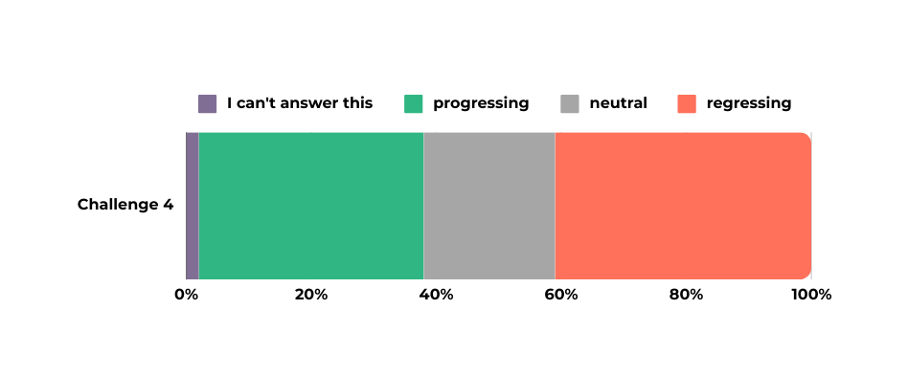
Progress made:
discourse is becoming more evidence-based
expansion of drug checking services in some regions
wider availability of naloxone and take-home methadone in some regions
Good Samaritan laws
increased global acknowledgment of the need for gender-sensitive health services
Challenge 4
Increase in drug-related deaths - unmet need for drug treatment and health services
Challenges encountered:
funding for health and treatment services remains insufficient
human rights abuses
disproportionate focus on law enforcement measures
neglect of evidence-based prevention, especially for children and young people
limited access to life-saving medications
NGO responses:
providing evidence-based health services (prevention, harm-reduction, treatment, and recovery)
advocacy
Notes:
NM - Some NGOs emphasized the increasing dialogue and cooperation among different actors, with the discourse becoming more evidence-based. Access to drug checking services has also expanded, and some NGOs can offer such services at the community level, although their availability remains limited. Some NGOs reported a wider availability of naloxone in community settings, contributing to overdose prevention, and availability of take-home methadone as well. While increased recognition of gender-sensitive health services was welcomed, the ongoing need for services tailored to vulnerable groups, such as women, children, people experiencing homelessness, individuals with co-occurring disorders, and people in prisons and other places of detention or closed settings, was also raised. The need for decriminalization of drug use and possession for personal use, and the importance of laws providing immunity from prosecution for drug offenses when reporting an overdose to emergency services (e.g., Good Samaritan laws), were often underscored.
Funding for health and treatment services remains insufficient, resulting in inadequate coverage, especially for marginalized populations. Human rights abuses, ineffective trials, and harmful consequences associated with prisons and compulsory rehabilitation centers in some countries. The often disproportionate focus on law enforcement measures was seen as a significant challenge, along with limited or nonexistent harm reduction services in certain countries. Some participants stressed the neglect of evidence- based prevention, especially for children and young people, and the insufficient attention given to holistic solutions offering a continuum of care. Limited access to life-saving medications like naloxone, methadone, and buprenorphine in many countries. A number of participants indicated that treatment and rehabilitation services were often inaccessible due to barriers such as availability, costs, and the stigma associated with treating substance use disorder.
Myriad of interventions showcasing the diverse efforts of NGOs, from advocacy to direct service provision, all geared towards enhancing the well-being of the communities they serve. Some highlighted their advocacy work with governments for decriminalization, provision of naloxone, and harm reduction services ranging from NSP to supervised consumption services and drug checking services. Others outlined their focus on providing evidence-based prevention, treatment, and recovery, ensuring accessibility for all individuals.

Slide 9
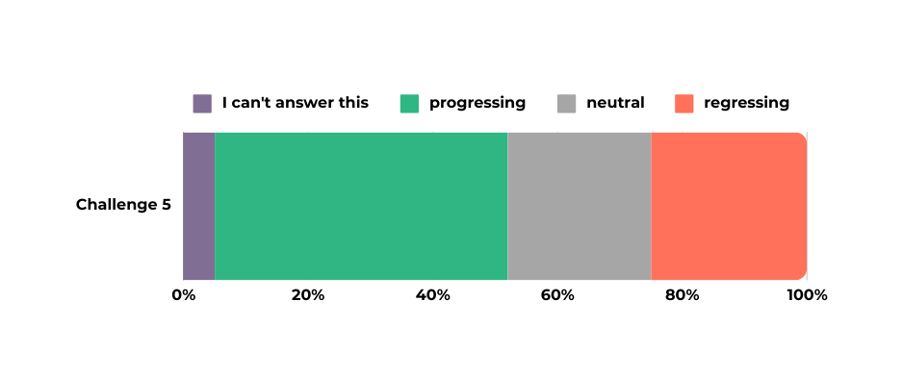
Progress made:
accessible, and affordable prevention, harm reduction, testing, diagnosis, treatment, and recovery services being offered
decline in HIV and HCV among people using drugs
successful PrEP programs available for men having sex with men and people who use drugs
Challenge 5
High transmission of HIV, HCV and other blood-borne diseases associated with drug use
Challenges encountered:
lack of funding for community-led initiatives and harm reduction programs
absence of comprehensive prevention and harm reduction
limited access to controlled medicines for pain relief
limited and HIV and HCV testing for people who use drugs and HIV prevention for chemsex
criminalization, racism, and discrimination against Indigenous, Black, and brown people results in people from these communities disengaging from or actively avoiding health services
NGO responses:
improving education, prevention and harm reduction initiatives
advocacy
Notes:
NM - Progress in high-income countries with comprehensive, accessible, and affordable prevention, harm reduction, testing, diagnosis, treatment, and recovery services being offered. Attributed the decline in HIV and HCV among people using drugs to community- based and harm reduction responses with key actions including building a community approach, utilizing services with access points for people who use drugs, peer-based approaches, and adopting comprehensive and coordinated strategies. Progress was also perceived in HIV prevention sustainability, with successful PrEP programs available for men having sex with men and people who use drugs. Initiatives addressing chemsex were also highlighted.
Critical issue of funding. Some participants identified the absence of comprehensive prevention and harm reduction programs as major obstacles. Limited access to controlled medicines for pain relief and insufficient donor funding further impact services in low-income countries. Access remains limited and HIV and HCV testing for people who use drugs and HIV prevention for chemsex users is often still insufficient. Overarching structural problems also negatively affect access to services. Criminalization, racism and discrimination against Indigenous, Black, and brown people results in people from these communities disengaging from or actively avoiding health services.
NGOs are involved in educating health professionals on the transmission of HIV, HCV, and blood-borne diseases associated with drug use. They often implement a multifaceted approach, including prevention strategies, harm reduction initiatives, voluntary HIV testing, as well as guiding affected individuals to appropriate care facilities. In addition, many organizations provide vital harm reduction services, such as NSP and HIV testing. Advocacy efforts also play an important role in addressing the high transmission of HIV and HCV, with some respondents indicating that they are involved in community awareness campaigns.

Slide 10
Progress made:
establishing and maintaining a quality Early Warning System in Europe
increased but still insufficient number of civil society-led drug checking services, enhanced poison and toxicity information, and improved cooperation between authorities nationally and internationally
proliferation of civil society websites and tools has facilitated better information sharing
Challenge 6
Adverse health consequences associated with new psychoactive substances
Challenges encountered:
training needed to address health risks and overdoses caused by NPS use
difficulty in reaching "harder-to-reach" people who use NPS, with a lack of specialized prevention, harm reduction, treatment, recovery, and counseling services
scheduling, blanket bans, new prohibitions, and enforcement crackdowns have been unsuccessful in curbing supply and demand, leading to market mutations that increase harm
NGO responses:
increase on capacity building and training for health providers and psychologists
increase evidence-based prevention curricula and training programs to communities and schools
harm reduction services, including drug checking services, as well as peer support mechanisms to minimize health risks for people who use drugs
Notes:
NM - Significant progress that has been made by establishing and maintaining a quality Early Warning System in Europe by the European Monitoring Centre on Drugs and Drug Addiction (EMCDDA) and the network of REITOX National Focal Points (NFPs). This system relies on data from civil society organizations, underscoring the need for closer cooperation between government agencies and NGOs. The region has witnessed an improved scientific understanding of the effects and health problems related to NPS, an increased but still insufficient number of civil society-led drug checking services, enhanced poison and toxicity information, and improved cooperation between authorities nationally and internationally. The proliferation of civil society websites and tools has facilitated better information sharing, leading to more efficient early warning systems and classification processes.
More training for police, medical staff and staff in nightlife venues is needed to address health risks and overdoses caused by NPS use. There is also a significant difficulty in reaching "harder-to-reach" people who use NPS, with a lack of adequate and specialized prevention, harm reduction, treatment, recovery, and counseling services, especially for youth. Scheduling, blanket bans, new prohibitions, and enforcement crackdowns have been unsuccessful in curbing supply and demand, leading to market mutations that increase harm. Examine the ramifications of supply reduction interventions and to consider health interventions developed with people who use drugs and civil society that are better equipped to reduce harms, including tailored harm reduction interventions, decriminalization, and expanding access to safer supply initiatives.
Several respondents highlighted their focus on capacity building and training for health providers and psychologists, aiming to enhance their understanding of emerging substances and the associated health consequences. NGOs actively contribute by delivering evidence- based prevention curricula and training programs to communities and schools. Additionally, some organizations provide harm reduction services, including drug checking services, and establish peer support mechanisms to minimize health risks for people who use drugs.

Slide 11
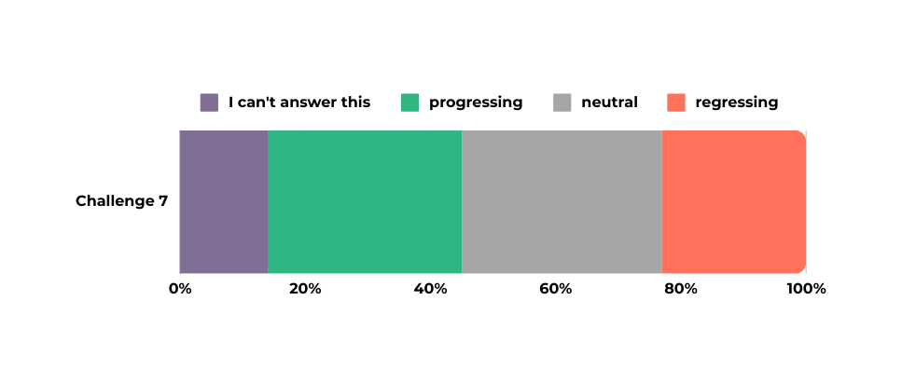
Progress made:
adoption of laws or policies that facilitate access to cannabis-based medicines in at least 18 countries since 2019
evolving therapeutic use of psychedelic substances for various illnesses, with over 450 clinical trials worldwide
Challenge 7
Low availability of internationally controlled substances for medical and scientific purposes
Challenges encountered:
over 82% of the global population has access to less than 17% of the world’s morphine-based medicines
40-fold difference in the availability of opioids for pain management and palliative care between high-income and low and middle-income countries, partly due to strict controls
complicated drug procurement procedures and supply chain challenges
factors such as "opioid phobia," cultural bias, fear of diversion towards the unregulated market, stigma reported by patients, lack of community knowledge, and insufficient funding for advocacy and awareness raising
civil society emphasized the need for proper research, data collection, and analysis, including documenting treatment effectiveness
NGO responses:
advocating for the availability of prescription pain medications for patients who need them, including through the provision of safer supply programs
when facing humanitarian crisis, violence, repression, hostility, and war, it is often NGOs that come up with solutions to continue delivering vital drug services (e.g. Ukraine)
Notes:
GB - Advancements in the regulation of controlled substances for pain relief and palliative care, which is linked to the adoption of laws or policies that facilitate access to cannabis-based medicines in at least 18 countries since 2019. In 2020, cannabis was removed from Schedule IV of the 1961 Single Convention on Drugs, recognizing its therapeutic value. The therapeutic use of psychedelic substances is also evolving for treating various illnesses, such as depression, anxiety, post-traumatic stress disorder (PTSD), and drug dependence, with over 450 clinical trials ongoing worldwide, mainly in high- income countries.
Over 82% of the global population has access to less than 17% of the world’s morphine-based medicines, and there is a 40-fold difference in the availability of opioids for pain management and palliative care between high-income and low and middle-income countries, partly due to strict controls. Complicated drug procurement procedures and supply chain challenges were pointed out as factors leading to the interruptions or shortages of essential medications. Some participants in regional consultations highlighted factors such as "opioid phobia," cultural bias, fear of diversion towards the unregulated market, stigma reported by patients, lack of community knowledge, and insufficient funding for advocacy and awareness raising. Civil society emphasized the need for proper research, data collection, and analysis, including documenting treatment effectiveness. Participants mentioned that countries often lack demographic data on health-related suffering and treatment needs using controlled substances. There is also a gap in research to understand the access barriers
in specific regions, as well as research on the therapeutic use of psychedelic substances, hindering the development of evidence-based solutions.

Slide 12
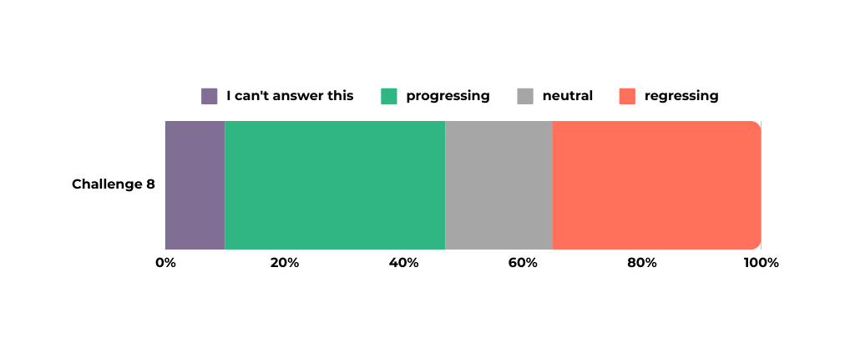
Progress made:
respondents from Africa and Asia-Pacific saw some progress made
respondents from Europe, North America, Latin America and the Caribbean saw regression
increased awareness among the public about corruption and other forms of organized crime
Challenge 8
Increasing links between drug trafficking, corruption and other forms of organized crime
Challenges encountered:
corruption
rising levels of perceived violence associated with unregulated drug markets
Africa: lack of synergies between stakeholders
Europe: increased use of ICT by organized crime groups
NGO responses:
building resilience among youth from marginalized groups
increasing collaborations between stakeholders and networking on regional & international levels
Notes:
GB

Slide 13
Progress made:
enhanced investigative tools and increased collaboration between countries
investing proceeds of confiscated goods in health and social services
Challenge 9
Low value of confiscated proceeds of crime related to money laundering arising from drug trafficking
Challenges encountered:
tax havens and insufficient regulation for finance operators
confiscation does not always seem to be an effective deterrent scheme
NGO responses:
only 18% of respondents indicated that their organization works to address this challenge
Notes:
GB

Slide 14
Progress made:
increased cooperation between countries to access encrypted messengers
Challenge 10
Criminal misuse of information and communications technologies for drug trafficking
Challenges encountered:
apparent lack of accountability/responsibility of major internet companies in removing harmful content
misuse of communications technology, misinformation, fake news, and state censorship
social media's role in drug transactions, providing convenience but posing risks.
NGO responses:
evidence-based drug prevention and harm reduction campaigns
Notes:
GB

Slide 15
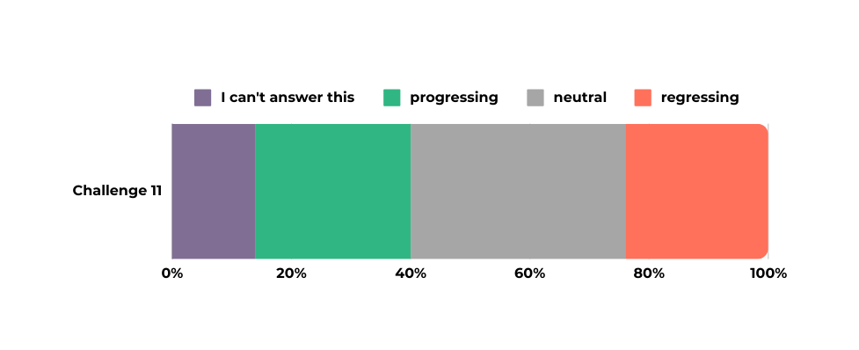
Progress made:
Africa and Asia-Pacific were more likely to indicate that they observed at least some progress
Europe, North America, Latin America and the Caribbean, as well as those working globally, were most likely to indicate that they had seen regression
Challenge 11
Non-compliance of responses with international drug control conventions and human rights obligations
Challenges encountered:
Non-respect of the human rights of people who use drugs: right to health, right to life, right to be free from torture and other cruel, inhuman or degrading treatment or punishment, right to be free from arbitrary arrest and detention, right to a fair trial, as well as the right to equality and freedom from discrimination, among others
Legalization and regulation of cannabis for non-medical and non-scientific purposes: some believed in conformity with conventions by upholding their overarching purpose, others maintained this went beyond flexibility offered; across all, concerns related to the challenge of commercialization of cannabis and corporate capture
NGO responses:
research and advocacy, producing publications and other resources, raising awareness, engaging with government officials, and strengthening partnerships
documenting human rights violations, delivering frontline services, and providing legal support to affected populations
Notes:
GB

Slide 16
Progress made:
Civil society involvement and collaboration
Prevention, treatment, and recovery
Harm reduction, safe/safer supply, and overdose prevention
Legal regulation
Other challenges:
Stagnancy of drug policies
Insufficient evaluation and lack of indicators to measure progress
War and crisis
Harassment and violence against civil society
Lack of funding
Emerging trends:
Increased engagement by UN human rights bodies
Focus on racial justice, equality, and non-discrimination
Criminalization of women and youth
Decolonization of the drug control regime
Addressing root causes of drug-related issues
Challenge 12 and Other
Availability of reliable data
Lack of reliable, comparable data
Lack of data on evidence-based prevention programs
Proposal for additional indicators, such as on human rights, harms and consequences of drug use (e.g., GDPI)
Notes:
GB

Slide 17
03
Improved access to harm reduction, treatment, and recovery services;
The Way Forward
04
Addressing root causes of drug-related issues, such as poverty, structural violence, racism, inequality, and lack of access to education and healthcare;
Respondents identified key issues that need to be addressed to ensure that drug related matters are adequately tackled in the next years:
05
A shift towards health-focused policies rather than punitive measures;
01
Capacity building and comprehensive public health training;
06
Enhanced collaboration across UN bodies to enhance coherence between the international drug control regime and international human rights obligations, placing equality and non-discrimination at the center of drug policymaking.
02
Investment in evidence-based prevention interventions;
Notes:
GB

